Slide 1

Brute Forcing
19CSE335 Ethical Hacking

Slide 2
Brute Force- Definition
A Brute Force attack can be defined as an error or trial technique used by various application programs for decoding encrypted data like DES (Data Encryption Standard) or password keys.
The hackers can apply the Brute Force attacks to obtain access to any account or website, shut a site down, steals data, or executes other attack types.
The brute force attacks apply trial-error for guessing encryption keys, login info, or detect an unknown web page.
Brute Force means that they apply extra forceful attempts to try and force the way into our private accounts.
It is an old method of attack but still popular and effective with hackers. Depending on the password's complexity and length, cracking may take anywhere through many years or may a few seconds.

Slide 3
Brute Force Attack Working
The Brute Force attack will apply automated tools for guessing several username and password combinations until they detect the accurate input.

Slide 4
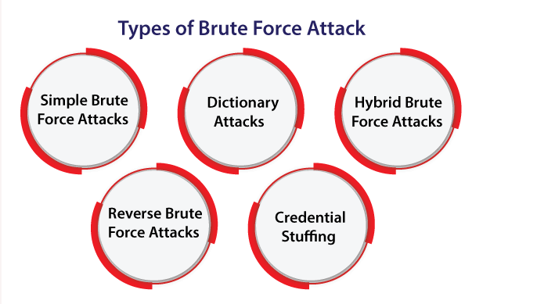
Types of Brute Force Attack

Slide 5
Simple Brute Force Attacks: Various hackers attempt for guessing our credentials logically- completely unassisted through many types of software tools. These could reveal simple PINs and passwords. For example, passwords like "guest12345".
Dictionary Attacks: The hacker selects a target and executes feasible passwords against the username within the standard attack. These are called dictionary attacks. These attacks are the most common attacks in brute force attacks. Often, these are used as the necessary element for password cracking. A few hackers execute from augment words, unabridged dictionaries, etc.
Hybrid Brute Force Attacks: Hybrid attacks can be defined as a combination of brute force attacks and dictionary attacks. These attacks can be used for detecting combo passwords which mix various common words along with some random characters. An example of brute force attacks of this type of nature will include passwords like Spike1234 or NewYork1993.
Reverse Brute Force Attacks: As its name implies, these attacks can reverse the strategy of attacks by beginning with any known password. After that, hackers will find a lot of usernames as far as they detect a match. A lot of criminals begin with some cracked password that is available online through existing breaches of data.
Credential Stuffing: When the hackers have a combo of username-password working for only a single website, they will try this combo on other websites also. Since the user has been acknowledged for reusing the login data across various websites, they're the targets of any attack like credential stuffing attacks.

Slide 6
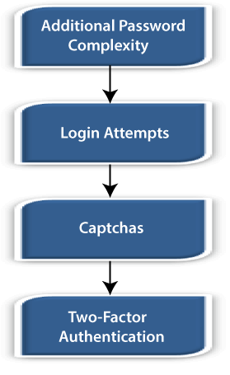
Brute Force Attack Prevention
Additional Password Complexity: This technique will make the procedure of guessing any password take longer significantly. A few websites will need an 8-16 characters password along with at least a number or letter with special characters (like "."). Some websites will not allow any user to include their ID, username, or name in the passwords.
Login Attempts: Additional login attempts will block out the users for any specified time amount that exceeds any specified attempts amount in inputting usernames/passwords.
Captchas: There are some boxes in these captchas. These boxes will display warped text and confirms to the user what the text within the box is. It will prevent bots from running various automated scripts that will appear within the brute force attacks, although being easy for humans to pass by.
Two-Factor Authentication: It will add a security layer to the main authentication form. Two-Factor authentication needs two authentication forms. For example, for singing into a new Apple device, the users will have to put within the Apple ID with the six-digit code, i.e., shown on other devices marked as trusted previously.

Slide 7
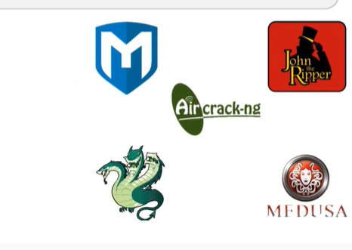
Metasploit
THC Hydra
John the ripper
Aircrack-ng
Hydra
Medusa

